Slide 1

Sales Prediction
Data Analyst Final Project 2020
Victor Triviño

Slide 2


SCENARIO
5 minutes later
Victor, I am worried about COVID and our sales. I heard you want to become a Data Analyst. May you help me to predict our numbers? I will send you an email.
Premise:
I do not care the product, what I want is the total number. $$$
PD: I rely on you, keep it in mind.
ALBERTO BIKING, THE BIKEHOP CEO

Slide 3
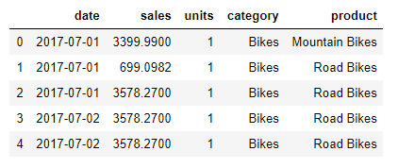


Data Preparation
Bikehop_daily_sales.xlsx
✔️ NO NULLS

Slide 4

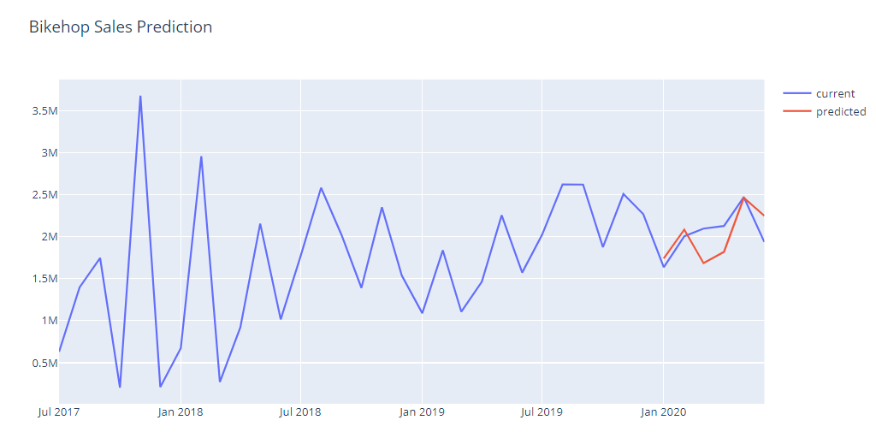
Long Short-term Memory with Keras
✔️ From time series to supervised problem: making data stationary
✔️ 75% of Adjusted R-Squared
✔️ MinMax Scaler
✔️ Build the model
units=4
loss='mean_squared_error',
optimizer='adam',
epochs=300,
batch_size=1
✔️ Calculate Prediction

Slide 5

KERAS Alberto’s feedback
Victor, that KERAS… New technology… Nevertheless, I do not see the final number. Come back next week with something new...

Slide 6

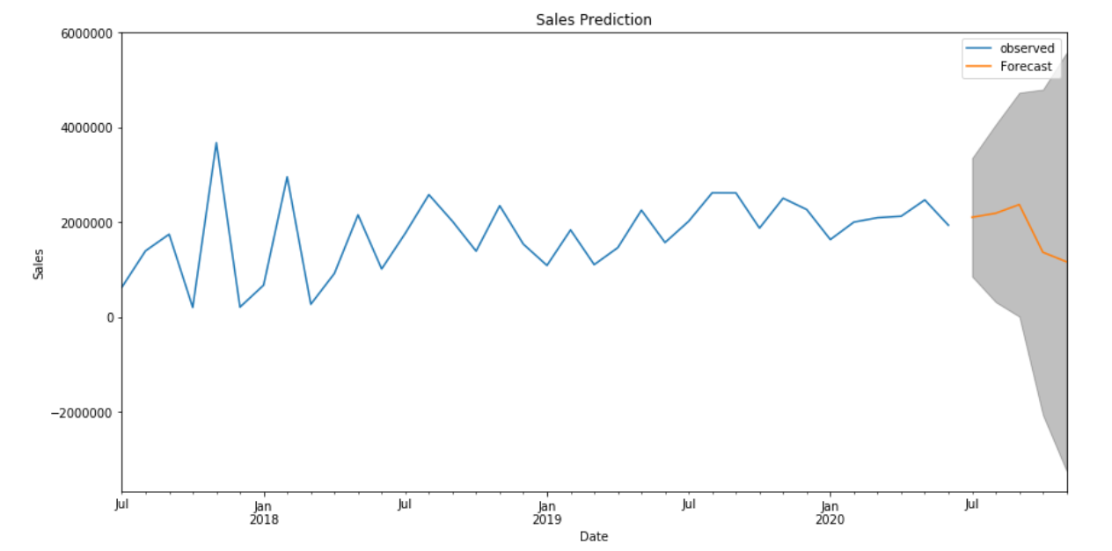
Time series with ARIMA and SARIMAX
✔️ Making data stationary:
eliminating trend and seasionality by decompositing the model
✔️ Build ARIMA model:
p:2
d:1
q: 2
✔️ Build SARIMAX with Grid Search
p:2
d:2
q:1
Seasonal order: (1,2,1,12)

Slide 7

ARIMA and SARIMAX Alberto’s feedback
Victor. That’s improving but can you do something better? Something more dynamic.
And one little change, I want the prediction for our products too.

Slide 8

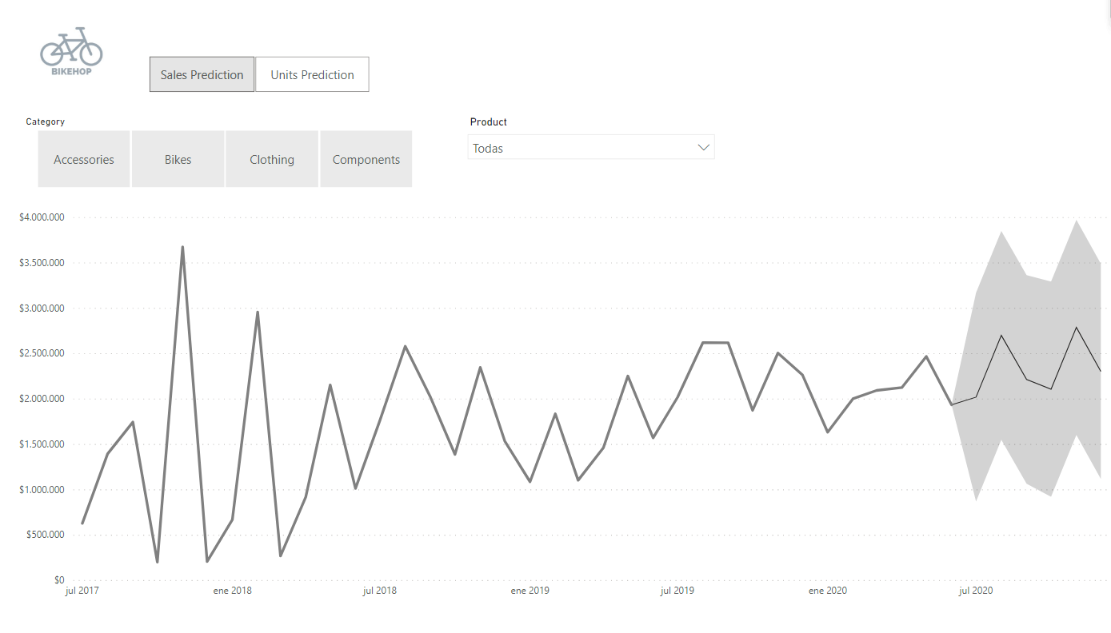
Power BI Prediction
✔️ ARIMA with a 95% confidence interval
✔️ Dynamic
✔️ Category and product detail with two simple clicks
✔️ Both sales and unit prediction in the same page
✔️ Lower bound
✔️ Prediction
✔️ Upper bound

Slide 9

Power BI Alberto’s feedback
Victor. That’s what I wanted. I can control sales, stock and everything. That’s MAGIC.

Slide 10
THANKS!!!!!!

